Slide 1
Tower defense design document (build 3.0)
Additional components with respect to build 2.0:
Final overview of class diagram
Included Exceptional Handling
Enhanced damage effects
Added additional patterns : State Pattern and Strategy pattern
Log files

Slide 2
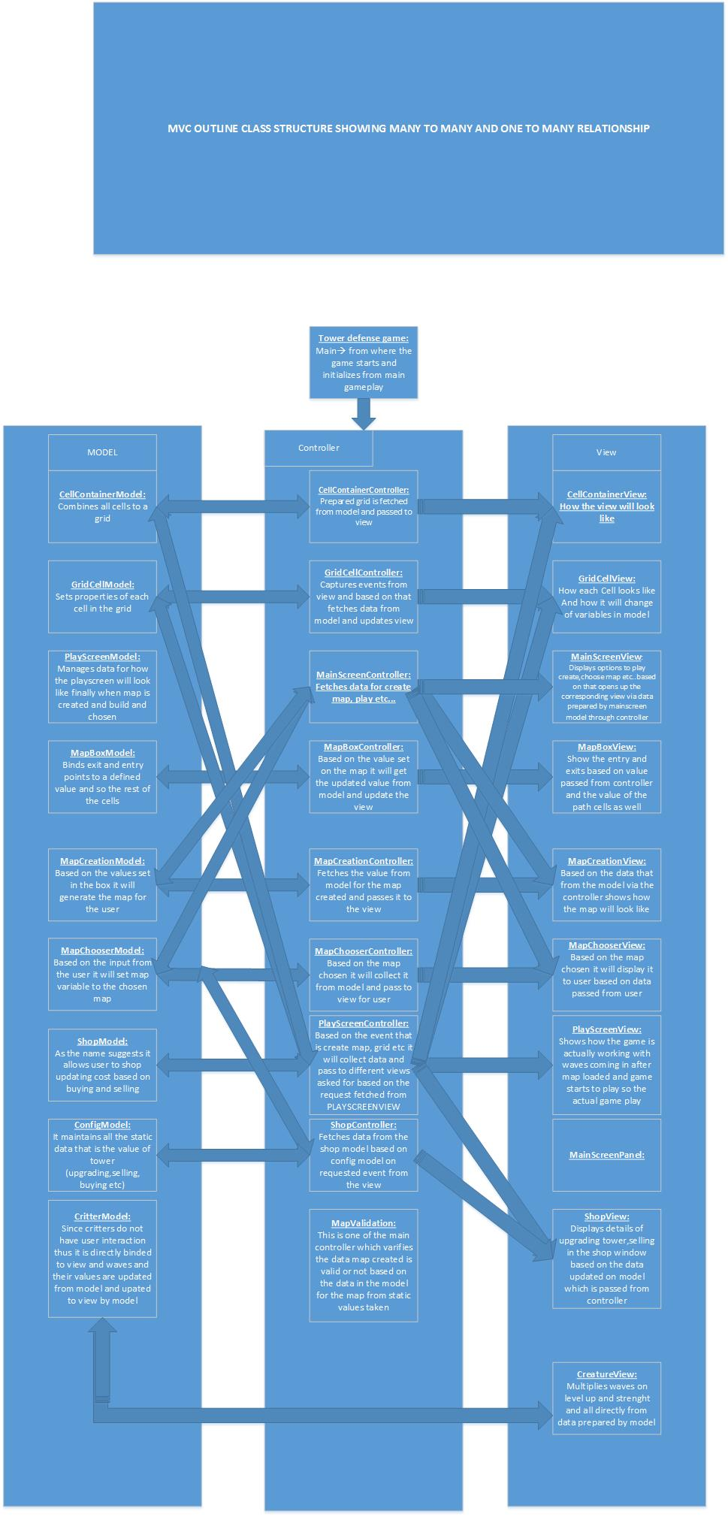

Slide 3
Why use exceptional handling?
In our game we have a wave of critters as a array list and based on the id of the critter which is the index value of the array the tower takes in the id of the critter in the array and starts to kill it but when there is no critter in the range then the id is set to -1 one for a split second using the ideology that is not critter is there in range it has been implemented that way and since the array index cannot take a negative value which might throw a array out of bound exception it might crash the game instead that is handled by just throwing a warning message and ask the tower to enter in a wait state and scan for the next available id to start killing again.

Slide 4
ENHANCED DAMGE EFFECTS:
Splash Effect:
It spills water on the enemy and kills it by one unit of damage
Fire Effect:
It burns down the enemy in time frames that is slows down burns it slows down burns it that is a higher damage than splash.
Freeze Effect:
It slows down the enemy so that the other towers can damage the enemy for more time and thus eventually killing it

Slide 5
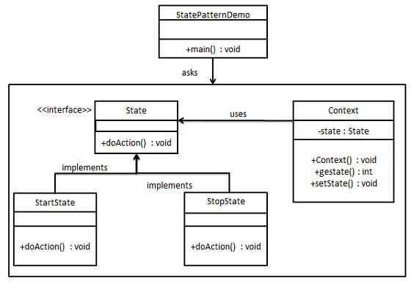
DESIGN PATTERNS
STATE PATTERN
What is state pattern?
In State pattern a class behavior changes based on its state. This type of design pattern comes under behavior pattern.
In State pattern, we create objects which represent various states and a context object whose behavior varies as its state object changes.
Why use state pattern?
In game play there are different states of the game which are defined as start state, pause state and end game state in thus there are different behaviour changes based on the state which identifies the player in which state the player is in based, for this we implemented a abstract class state which has three states : start game, stop game and pause game when ever there is change in state in context of the game a context variables gets the state and set the state to the current game state and updates the player with the present game state in which the game is in.

Slide 6
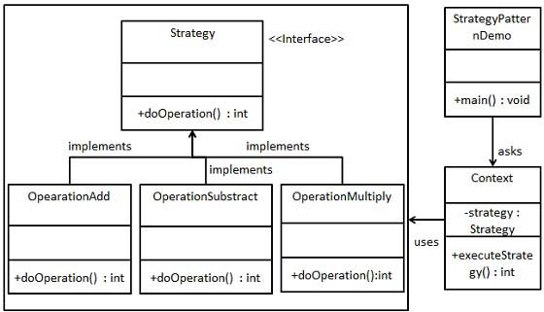
Strategy Pattern
What is strategy pattern?
In Strategy pattern, a class behavior or its algorithm can be changed at run time. This type of design pattern comes under behavior pattern.
In Strategy pattern, we create objects which represent various strategies and a context object whose behavior varies as per its strategy object. The strategy object changes the executing algorithm of the context object.
Why user strategy pattern?
Now a tower can have a different strategies like kill critter that is nearest to tower, maximum strength, weakest critter and finally killing the first enemy in the range (first come first serve).
To implement the same we have a strategy class having for different subclasses that implement all the 4 strategies mentioned above and each of them with different strategy algorithms when a tower is placed and at run time when anyone strategy for the tower is selected in context of the game by the user it will start executing that strategy for that particular tower.

Slide 7
Log Files
What is log?
A log generally maintains all up to date information of everything happening in the game at all times for a given application which helps in determining the performance of the game by analyzing that data, but it is always a good practice to maintain different log files for different components in the game which will help us to analyze that data for each of them separately and will be easy to determine there performance and also helps us to identify errors that might be happening which are behind the scenes.
Individual Tower Log File:
It maintains data for each individual tower (tower level..etc)
Collective tower log:
It combines tower log for all the towers
Wave Log:
It maintains all the information change in the wave of critters that is happening that is how much damage they took and every other thing that is happening with the critters
Global Log:
As the name suggests it is the super set of the logs and maintains all the information about the application whether it is related to a tower or critter etc.
IMPLEMENTATION:
How did we implement it ?
In order to implement if all the 4 logs stated above we have deviced a idea of creating 4 different windows which are updated as the game progresses as shown below.
P.S: Map log is created in different map files which are created at the time to map creation.

Slide 8
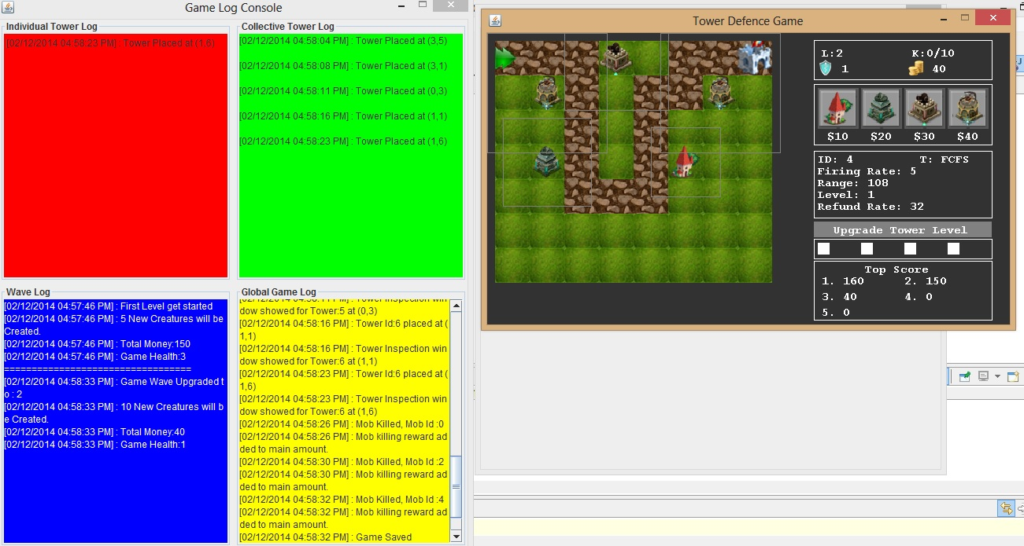

Slide 9
THE END

